Slide 1
CAPACITY DEVELOPMENT IN THE MENA REGION
ORANGE KNOWLEDGE PROGRAMME
INFO MEETING NUFFIC GLOBAL DEVELOPMENT 11 Jan 2021

Slide 2
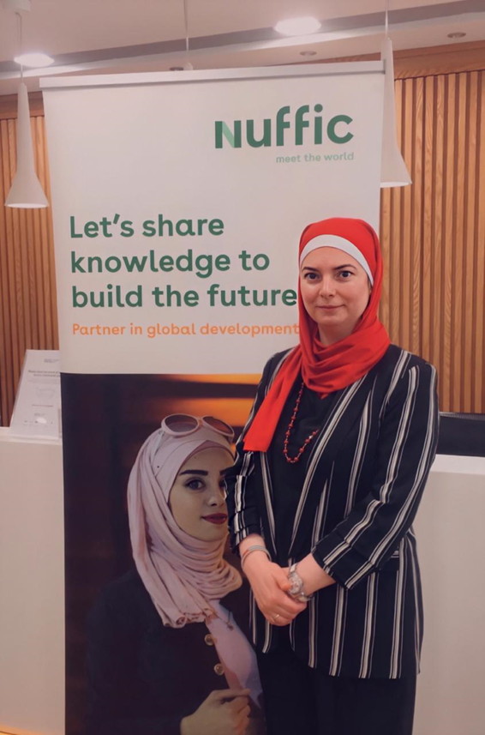
WELCOME
Dr. Reem Alkhader,
Regional Representative
for the Orange Knowledge Programme
based in Amman, Jordan.
Nuffic Global Development
Notes:
Milestones Omschrijving
1 juli 2017 t/m 31 juli 2022
A) Einddatum instrumenten incl. bijbehorende rapportages van grantees [contract]
B) Voor subsidieverlening in het kader van het OKP zal in de periode 2018–2022 in totaal € 185.381.751 beschikbaar zijn. Dit beschikbare bedrag wordt in de periode tot en met 31 juli 2022 verdeeld over diverse openstellingen [ subsidiebeleidskader]
1 nov 2022 Eindevaluatie door opdrachtgever (BZ)
31 jan 2023 Uiterste datum subsidievaststelling (obv de door ons ingediende eindrapportages)
31 jan 2023 Uiterste datum inleveren:
eind- en jaarlijkse financiële rapportage
eind - en jaarlijkse inhoudelijk analytisch voortgangsoverzicht
Controleverklaring en accountantsrapportage
Deadline Omschrijving
5 nov 2012 Aantreden kabinet Rutte II
15 mrt 2017 Kabinet Rutte II demissionair [termijn Rutte II volgemaakt]
31 juli 2017 Contractondertekening (plaatje)
9 sept 2017 Rijksbegrotingsstaat vermeldt verlenging capaciteitsopbouw middelen
26 Okt 2017 Aantreden kabinet Rutte III
16 mrt 2018 Publicatie Staatscourant gunning OKP
17 mrt 2021 Verkiezingen
Ca .juli 2021 Besluit nodig uitgaande van startdatum OKP II per 1 januari 2022

Slide 3
Orange Knowledge Programme
Contribute to sustainable and inclusive development through the strengthening of organisations key to sectoral development in partner countries. Interventions implemented have to contribute to the Netherlands’ development cooperation policy.

Slide 4
Description
The Orange Knowledge Programme is a Dutch funding programme. It contributes to societies’ social and economic development by strengthening knowledge and skills of professionals and organisations. This is achieved through focusing on education, in collaboration with Dutch knowledge organisations.
Funder: the Dutch Ministry of Foreign Affairs
Manager: Nuffic Global Development
Duration: from mid-2017 to mid-2022
Budget: € 220 million
Countries: projects are ongoing in up to 54 countries; currently new opportunities are available for 38 countries

Slide 5
Orange Knowledge Programme
https://www.youtube.com/watch?v=Jkl-Ab_5to4

Slide 6
Changing policy context
New focus areas and regions
Addressing root causes of instability, migration and hunger and promoting employment for youth, women and vulnerable groups
Horn of Africa: Somalia, Sudan and South Sudan; anchor role for Ethiopia
Sahel: Mali, Niger, Burkina Faso
Middle East, North Africa (MENA): FNS & Water

Slide 7
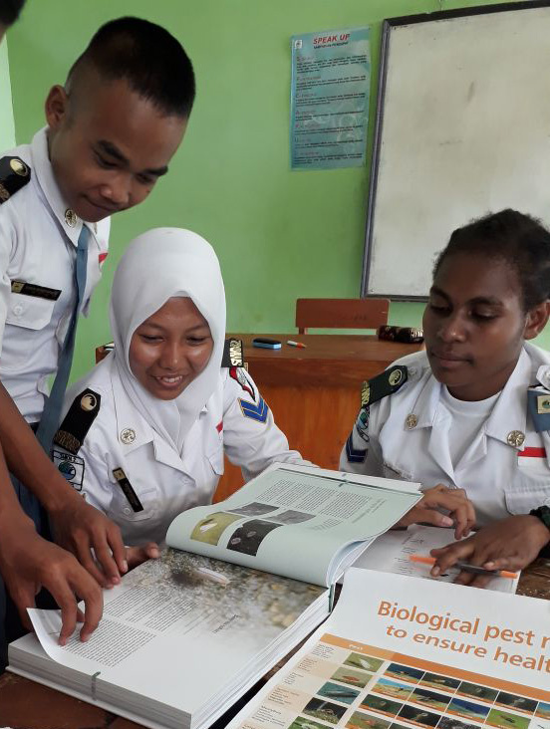
Introduction to the calls
Theory of Change
Specific calls
MENA region: Iraq and Jordan (institutional collaboration projects -ICP call)
Timeline
Regular calls
Individual scholarships
Tailor-made Training (TMT)
OKP in Iraq + Jordan

Slide 8
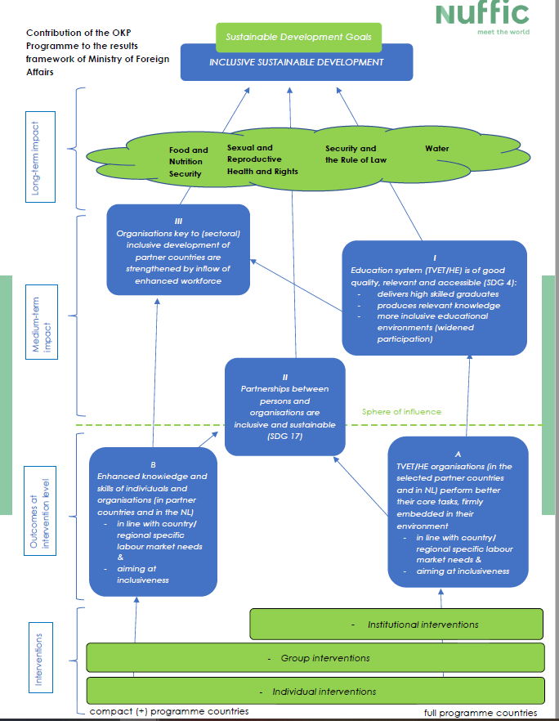
Theory of Change

Slide 9
Theory of Change
Notes:
The themes of Dutch development policy are closely linked to the SDGs: food security, water, sexual and reproductive health and rights including HIV/AIDS, security and the rule of law, women's rights and gender equality, climate, private sector development, humanitarian aid, improving prospects for refugees, and migration. What the Netherlands seeks to achieve in these areas is set out in thematic results frameworks, which include indicators and target values. These indicators are closely linked to the international SDG targets and indicators.

Slide 10
Theory of Change

Slide 11
Theory of Change

Slide 12
Theory of Change

Slide 13
Theory of Change

Slide 14
Theory of Change

Slide 15
Theory of Change

Slide 16
Theory of Change

Slide 17
Theory of Change

Slide 18
Three calls;
#1
MENA region: Iraq and Jordan (institutional collaboration projects -ICP call)
Strengthening national system capacities in efficient and sustainable horticulture farming - with a focus on applied skills development and improving agricultural TVET institutional structures
https://www.nuffic.nl/en/subjects/orange-knowledge-programme/calls-joint-proposals-institutional-collaboration-projects-okp

Slide 19
Timeline call procedure ICP
Call published
15 December 2020
Deadline call
18 February 2021
Selection proposals
March 2021
Start of projects
1 April 2021
Notes:
Please note: deadline TMT+ Sudan = 4 February 2021, 11.00 A.M CET

Slide 20
Other open calls for all Orange Knowledge countries
#2
Open call for TMT courses
Deadline 21 January 2021
#3
Individual scholarships for short courses;
Deadline 5 January 2021
#Future
3 more calls for short courses and 1 for Master’s courses

Slide 21
OKP Individual Scholarships – Short Course call open until 5 January 2021
Regular call – open to all OKP partner countries
Target group: professionals, currently employed
Scholarships available for: Short Courses (2 – 52 weeks) & Master's
2021: 1 Master call, 3 Short Course calls
Applications should be in line with CPI/Country Focus
Information for applicants: https://www.studyinholland.nl/okp
Eligible courses: https://www.studyinholland.nl/dutch-education/studies?okp_qualified=yes
How to apply? Find a course, apply with the educational institution for the course + the OKP scholarship

Slide 22
Tailor-made Training (TMT) - call open until 21 January 2021
All Dutch training providers are eligible, including NGO’s, consultancies and knowledge institutions.
Proposals should target key organisations in Jordan.
At least 1 organisation from Jordan, 1 Dutch training provider and 1 anchor organisation must jointly formulate a training proposal.
The joint proposal must be submitted by a Dutch training provider.
Applicants are expected to demonstrate a high level of knowledge regarding the country context for which a proposal is submitted, particularly regarding the institutional setting in the target country and content of the proposal.
In addition to staff training, the proposal may incorporate other activities, for example: short courses, internships, study visits, small investments, if these clearly contribute to the content and goals of the project.
The available funding for this deadline is € 2.9 million. The maximum subsidy is € 75,000 per Tailor-Made Training.
Grant Obligations and Conditions.
https://www.nuffic.nl/en/subjects/orange-knowledge-programme/call-joint-proposals-tailor-made-training-tmt-orange-knowledge
Notes:
The Orange Knowledge Programme aims to strengthen the capacity of local organisations through education and training.
TMT+ can also target professionals who have a common training need, but who are not staff members of the same organisation.
More information on Nuffic’s website, including how to find partners

Slide 23
MENA region
Iraq & Jordan (institutional collaboration projects -ICP call)

Slide 24
MENA region ICP
Call for joint proposals (ICP) OKP-MENA-30012
Strengthening national system capacities in efficient and sustainable horticulture farming - with a focus on applied skills development and improving agricultural TVET institutional structures
Budget max EUR 1,900,000 (incl. 900K scholarship facility)
1/4/2021 – 31/3/2022
Deadline: 18 February 2021, 11.00 A.M CET
Deadline for questions: 25 January 2021, 11.00 A.M. CET

Slide 25
MENA region ICP
Characteristics
Focus on Food and Nutrition Security and Water
Strengthening national system capacities in (water-) efficient and sustainable horticulture farming
Strengthening the Technical and Vocational Education and Training (TVET) sectors in both countries
Strengthening professionals' capacities with emphasis on greenhouse technology adaption and the design, developing value chains and postharvest systems including construction and installation of post-harvest facilities
North-South-South cooperation: experts from the region in the Dutch consortium
Integrated approach: institutional collaboration to reinforce individual scholarships and group trainings and vice versa
Synergy: build upon prior/ongoing collaborations and achievements
Notes:
FNS-REPRO project which builds on the 2018 Security Council's resolution on conflict and food security (UNSCR 2417). FNS-REPRO has three broad tracks: improving rural communities' access to and management of natural resources; generating enhanced and new livelihood opportunities along agricultural value chains; and enhancing people's capacity to explore and take advantage of those new opportunities. The Orange Knowledge regional programme specifically aims at strengthening institutional capacities for and in these value chains.

Slide 26
MENA region ICP
Characteristics - New
Local scholarship facility
900K earmarked for local scholarship facility for > 110 horticulture sector professionals
Short courses/trainings/applied research assignments horticulture sector professionals
Offered by knowledge institutions and training centres in Iraq & Jordan or in the MENA region
Only Dutch training courses provided by (a) Dutch institution(s) that is(are) part of the consortium
Eligible costs: studies in question finalised < 30 September 2022
Proposal includes: scholarship facility's set up, management plan and its contribution to longer term capacity investment
Preference Jordanian partner managing the scholarship facility
Notes:
FNS-REPRO project which builds on the 2018 Security Council's resolution on conflict and food security (UNSCR 2417). FNS-REPRO has three broad tracks: improving rural communities' access to and management of natural resources; generating enhanced and new livelihood opportunities along agricultural value chains; and enhancing people's capacity to explore and take advantage of those new opportunities. The Orange Knowledge regional programme specifically aims at strengthening institutional capacities for and in these value chains.

Slide 27
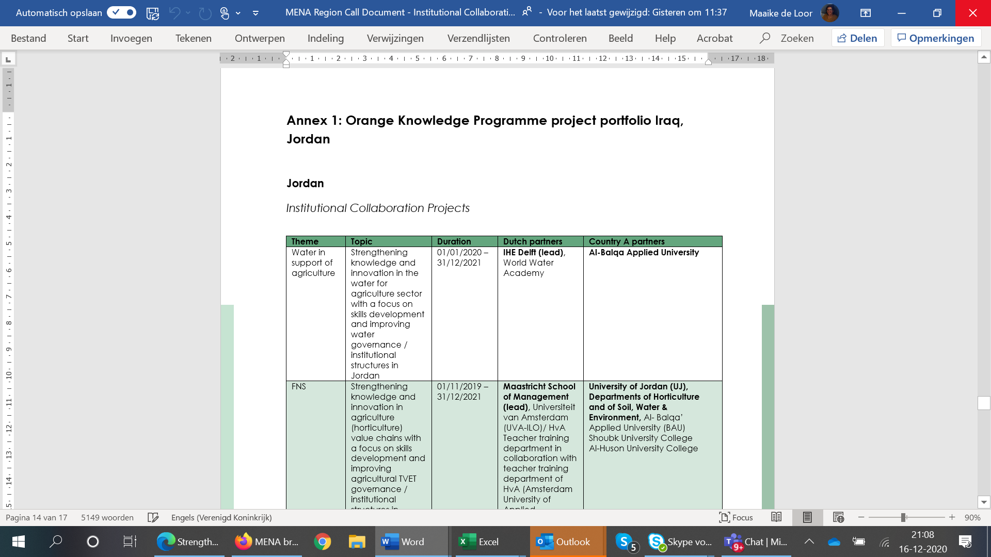
Integration, alignment and synergy
OKP in Iraq + Jordan =
11 TMT+ projects
3 ICP projects
Scholarships
9 FNS projects
3 Water in support of agri
28 ROs - 'local' / single count
23+ ‘Dutch’ partners / single count

Slide 28
MENA region ICP call
Institutional Collaboration Projects (ICPs):
The grant applicant must be a Dutch institution for secondary vocational or higher vocational or academic education; or a national or local knowledge institution or organisation.
A grant application (proposal) may be submitted by any one of the partners, potentially on behalf of a consortium.
The project proposal has a minimum duration of one year and must be implemented and established by no later than 31 March 2022
The proposal should target integrated capacity development through staff training, curriculum development, internships, study visits, small investments, if these clearly contribute to the content and goals of the project.
No staff salaries for target organisations.
Grant Obligations and Conditions
https://www.nuffic.nl/en/subjects/orange-knowledge-programme/calls-joint-proposals-institutional-collaboration-projects-okp
Notes:
The Orange Knowledge Programme aims to strengthen the capacity of local organisations through education and training.
As the implementation time for this project will be approximately 1 year, it is important that applications build upon prior and/or ongoing cooperation in order to immediately be up to speed.

Slide 29
Timeline call procedure ICP
Call published
15 December 2020
Deadline call
18 February 2021
Selection proposals
March 2021
Start of projects
1 April 2021
Notes:
Please note: deadline TMT+ Sudan = 4 February 2021, 11.00 A.M CET

Slide 30
MENA region ICP call
Questions?
Notes:
The Orange Knowledge Programme aims to strengthen the capacity of local organisations through education and training.
As the implementation time for this project will be approximately 1 year, it is important that applications build upon prior and/or ongoing cooperation in order to immediately be up to speed.

Slide 31
MENA Region
All information on our website: https://www.nuffic.nl/en/subjects/open-calls
If you agree on sharing your contact details, please send us an email: okp@nuffic.nl
Thanks for your participation

