Slide 1
CAPACITY DEVELOPMENT IN THE MENA AND HORN OF AFRICA REGIONS
ORANGE KNOWLEDGE PROGRAMME
INFO MEETING NUFFIC GLOBAL DEVELOPMENT 17 DEC 2020

Slide 2
Two break-out sessions:
MENA region: Iraq and Jordan
Strengthening national system capacities in efficient and sustainable horticulture farming - with a focus on applied skills development and improving agricultural TVET institutional structures (ICP call)
Horn of Africa:
Focus on Somalia (Sool and Sanaag): Horticulture (ICP)
Focus on Sudan (Darfur) Gum Arabic (TMT+)
Notes:
Countries in which OKP (regional) projects related to SRHR/Health are currently being implemented.
Take into consideration as much as possible the country plans of implementation in those countries where this partnership will be rolled out, especially in the area of SRHR / health and education, to avoid duplication of efforts!

Slide 3
Break out session MENA region
Iraq & Jordan

Slide 4
MENA region ICP
Call for joint proposals (ICP) OKP-MENA-30012
Strengthening national system capacities in efficient and sustainable horticulture farming - with a focus on applied skills development and improving agricultural TVET institutional structures
Budget max EUR 1,900,000 (incl. 900K scholarship facility)
1/4/2021 – 31/3/2022
Deadline: 18 February 2021, 11.00 A.M CET
Deadline for questions: 25 January 2021, 11.00 A.M. CET

Slide 5
MENA region ICP
Characteristics
Focus on Food and Nutrition Security and Water
Strengthening national system capacities in (water-) efficient and sustainable horticulture farming
Strengthening the Technical and Vocational Education and Training (TVET) sectors in both countries
Strengthening professionals' capacities with emphasis on greenhouse technology adaption and the design, developing value chains and postharvest systems including construction and installation of post-harvest facilities
North-South-South cooperation: experts from the region in the Dutch consortium
Integrated approach: institutional collaboration to reinforce individual scholarships and group trainings and vice versa
Synergy: build upon prior/ongoing collaborations and achievements
Notes:
FNS-REPRO project which builds on the 2018 Security Council's resolution on conflict and food security (UNSCR 2417). FNS-REPRO has three broad tracks: improving rural communities' access to and management of natural resources; generating enhanced and new livelihood opportunities along agricultural value chains; and enhancing people's capacity to explore and take advantage of those new opportunities. The Orange Knowledge regional programme specifically aims at strengthening institutional capacities for and in these value chains.

Slide 6
MENA region ICP
Characteristics - New
Local scholarship facility
900K earmarked for local scholarship facility for > 110 horticulture sector professionals
Short courses/trainings/applied research assignments horticulture sector professionals
Offered by knowledge institutions and training centres in Iraq & Jordan or in the MENA region
Only Dutch training courses provided by (a) Dutch institution(s) that is(are) part of the consortium
Eligible costs: studies in question finalised < 30 September 2022
Proposal includes: scholarship facility's set up, management plan and its contribution to longer term capacity investment
Preference Jordanian partner managing the scholarship facility
Notes:
FNS-REPRO project which builds on the 2018 Security Council's resolution on conflict and food security (UNSCR 2417). FNS-REPRO has three broad tracks: improving rural communities' access to and management of natural resources; generating enhanced and new livelihood opportunities along agricultural value chains; and enhancing people's capacity to explore and take advantage of those new opportunities. The Orange Knowledge regional programme specifically aims at strengthening institutional capacities for and in these value chains.

Slide 7
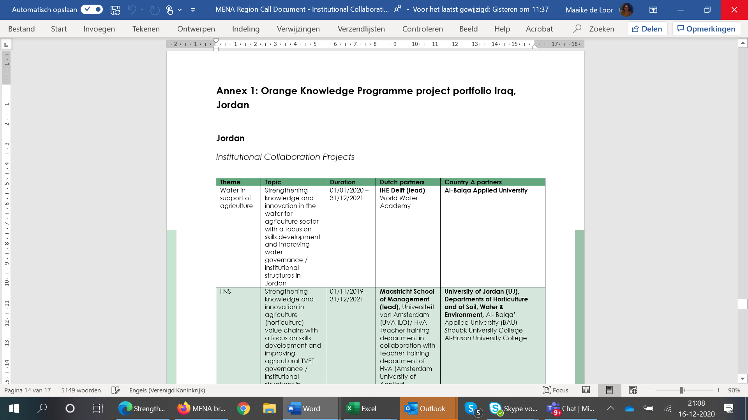
Integration, alignment and synergy
OKP in Iraq + Jordan =
11 TMT+ projects
3 ICP projects
Scholarships
9 FNS projects
3 Water in support of agri
28 ROs - 'local' / single count
23+ ‘Dutch’ partners / single count

Slide 8
MENA region ICP call
Institutional Collaboration Projects (ICPs):
The grant applicant must be a Dutch institution for secondary vocational or higher vocational or academic education; or a national or local knowledge institution or organisation.
A grant application (proposal) may be submitted by any one of the partners, potentially on behalf of a consortium.
The project proposal has a minimum duration of one year and must be implemented and established by no later than 31 March 2022
The proposal should target integrated capacity development through staff training, curriculum development, internships, study visits, small investments, if these clearly contribute to the content and goals of the project.
No staff salaries for target organisations.
Grant Obligations and Conditions
Notes:
The Orange Knowledge Programme aims to strengthen the capacity of local organisations through education and training.
As the implementation time for this project will be approximately 1 year, it is important that applications build upon prior and/or ongoing cooperation in order to immediately be up to speed.

Slide 9
Timeline call procedure ICP
Call published
15 December 2020
Deadline call
18 February 2021
Selection proposals
March 2021
Start of projects
1 April 2021
Notes:
Please note: deadline TMT+ Sudan = 4 February 2021, 11.00 A.M CET

Slide 10
MENA region ICP call
Questions?
Notes:
The Orange Knowledge Programme aims to strengthen the capacity of local organisations through education and training.
As the implementation time for this project will be approximately 1 year, it is important that applications build upon prior and/or ongoing cooperation in order to immediately be up to speed.

Slide 11
Other open calls for all Orange Knowledge countries
Individual scholarships for short courses; deadline 5 January 2021
Open call for TMT courses; Deadline 21 January 2021
2021 -> 3 more calls for short courses and 1 for Master’s courses
Information for applicants: https://www.studyinholland.nl/okp
Eligible courses: https://www.studyinholland.nl/dutch-education/studies?okp_qualified=yes

Slide 12
MENA Region
All information on our website: https://www.nuffic.nl/en/subjects/open-calls
If you agree on sharing your contact details, please send us an email: okp@nuffic.nl
Thanks for your participation

